Slide 1







Store Management System

Slide 2





TEAM
Team Name: Code Scientist
Batch: WDPF/NCLC-M/54/01
Round - 54
Sheikh Rownakul Islam Miraj
ID: 1272486
Backend
Development
Ali Hasan
ID: 1272524
Frontend
Development
Mosharrof Hossain
ID: 1272786
Testing and
Quality Assurance
Khaleda Akter
ID: 1273523
Security &
Bug fixing
Md Alamin
ID: 1273478
Database & Design

Slide 3
Index
INDEX OF PROJECT | Slide No.
Proposal Application | 4
Introduction | 5
Objectives | 6
Benefits | 7
Software Features | 8
Entity Relationship Diagram | 9
Software Flowchart | 10
Modules | 11
Timeline and Milestone | 12
Technical Information Source | 13
Use of Tools and Technologies | 14
Team Roles | 15
Methodology | 17
Example of Invoice Reports | 18
Forms Samples | 20
Conclusion | 22

Slide 4
Application
6th June, 2023
The Consultant
IDB Bhaban,
Sher e Bangla, Nagar, Dhaka
Subject: Project proposal letter for the Store Management System
Dear sir,
Thank you for offering us a great opportunity to make a real life project based on our core course that is Web Development with PHP and Framework(WDPF). In this project, I would like to inform you that We have decided to make a project on Store Management System, which is most important for every store owner. We have studied about the various aspects of the system and make a proposal accordingly which is enclosed here with for your kind perusal. So, We think you will finally Approved the project and help to utilize our creativity.
Sincerely,
Team: Code Scientist
Batch: WDPF/NCLC-M/54/01
Round - 54

Slide 5
Introduction
The purpose of this project proposal is to present the development of a comprehensive Store Management Application that will serve as a centralized solution for managing various aspects of your store's operations.
Our team aims to address the existing challenges in order management, inventory control, and financial tracking by leveraging the power of technology and creating a tailored software solution.
This Store Management Application will offer a user-friendly interface and intuitive features, empowering your staff to efficiently handle sales, inventory, and customer management tasks.
With a focus on automation and data-driven decision-making, this application will streamline processes, reduce manual errors, and enhance overall productivity.
By adopting this solution, your store will gain a competitive edge, as you will have real-time access to key performance indicators, enabling you to make informed business decisions promptly.

Slide 6
Objectives
Automate the process of order management, including order placement, tracking, and fulfillment.
Implement a centralized inventory management system for efficient tracking of stock levels, replenishment, and supplier management.
Integrate robust reporting and analytics capabilities to gain insights into sales trends, product performance, and profitability.
Enhance security measures to protect sensitive customer and financial data.
Enable seamless integration with existing systems, such as accounting software and POS (Point of Sale) systems.
Provide user-friendly interfaces for easy navigation and quick adoption by store staff.
Offer scalability and customization options to accommodate future growth and evolving business needs.
Ensure compatibility with multiple devices, including desktops, tablets, and mobile devices, for on-the-go access to store management features.

Slide 7
Benefits
Increased accuracy and productivity in managing store operations.
Real-time tracking and analysis of sales and inventory data for informed decision-making.
Improved customer satisfaction through streamlined order management and invoicing processes.

Slide 8
Software Features
Inventory Management:
Track stock levels, including product quantities, availability, and replenishment.
Set up low-stock alerts and automated reordering processes.
Sales Order Tracking:
Capture customer orders, including product details, quantities, and pricing.
Enable order status tracking .
Generate invoices and packing slips for efficient order fulfillment.
Reporting and Analytics:
Generate real-time reports on sales, inventory levels, and profitability.
Provide insights into top-selling products, customer buying patterns, and revenue trends.
Support customization and filtering options for tailored analysis.

Slide 9
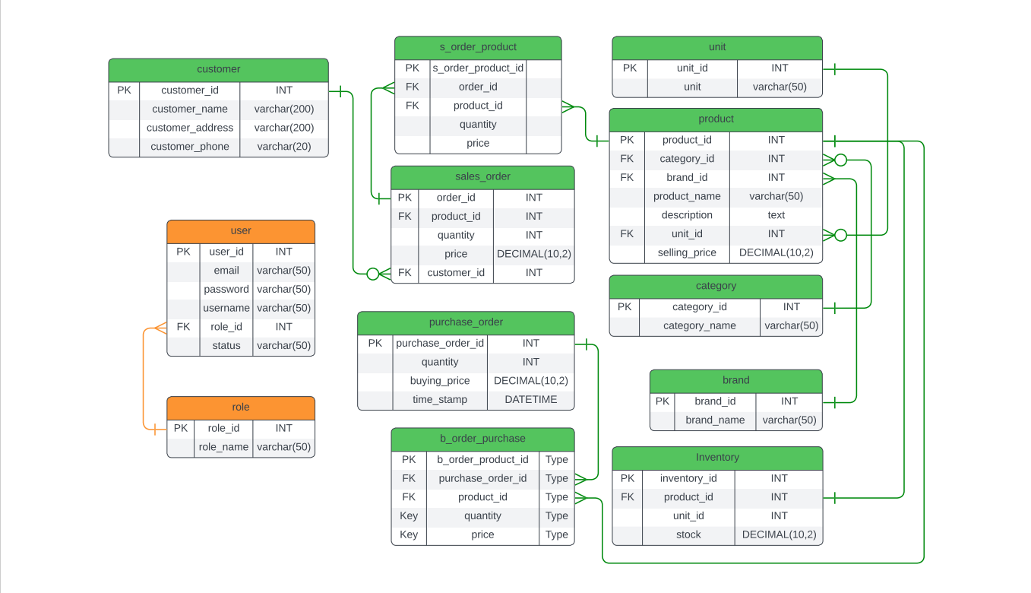
ERD – Entity Relationship Diagram

Slide 10
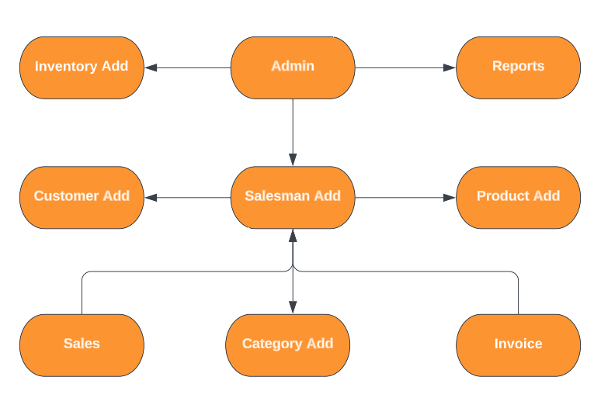
Software Flowchart

Slide 11
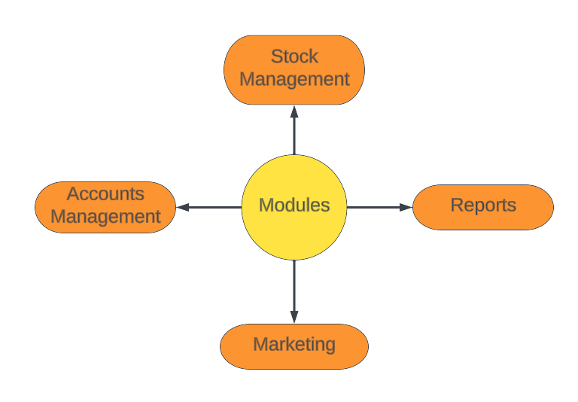
Modules:

Slide 12
Timeline And Milestone:
Milestone | Duration (Days)
Requirements Gathering | 2
Design and User Interface | 5
Development and Coding | 15
Testing and Quality Assurance | 5
Deployment and Launch | 2
Project Completion and Handover | 1
Total Duration | 30

Slide 13
Technical Information Source:
Information Source | Description
PHP.net | Official documentation and reference for PHP programming language
MySQL.com | Official documentation and resources for MySQL database management system
W3Schools | Online tutorials and guides for web development technologies, including PHP and MySQL
Stack Overflow | Online community for programmers to ask and answer technical questions
GitHub Repositories | Open-source projects and code repositories for PHP and MySQL

Slide 14
Use of Tools and Technologies:
Tools and Technology | Description | Tools and Technology | Description
PHP | Server-side scripting language used for dynamic web development | jQuery | JavaScript library for simplifying HTML document traversal and manipulation
MySQL | Relational database management system for storing and retrieving data | Git | Version control system for tracking and managing code changes
HTML | Markup language for creating the structure and content of web pages | PhpStorm | Integrated development environment (IDE) for PHP development
CSS | Styling language for enhancing the appearance and layout of web pages | phpMyAdmin | Web-based administration tool for managing MySQL databases
JavaScript | Client-side scripting language for interactive and dynamic web functionality | Bootstrap | CSS framework for creating responsive and mobile-friendly web designs

Slide 15
Team Roles
Sheikh Rownakul Islam Miraj
Designing and implementing the database schema
Developing the server-side scripts
Md Alamin
Managing database connections and query optimization
Designing and creating the user interface using HTML, CSS, and JavaScript
Ali Hasan
Implementing interactive features and forms
Handling user input validation and error handling
Khaleda Akter
Integrating with backend and retrieving data from the server
Implementing data validation and security measures
Mosharrof Hossain
Developing test plans and test cases
Performing functional testing, usability testing, and performance testing
Identifying and reporting bugs and issues
Collaborating with the other team members to resolve bugs and verify fixes

Slide 16
Methodology
Agile Development Approach:
We will adopt an Agile development approach to provide flexibility and adaptability throughout the project lifecycle.
Agile emphasizes iterative development, collaboration, and regular feedback to deliver incremental value to stakeholders.
Our team will specifically follow the Scrum framework, which divides the project into sprints and emphasizes frequent communication and collaboration.
Design and Development Phase:
Our team will design the database schema and establish the necessary entity relationships for efficient data management.
We will develop the front-end user interface using PHP, ensuring an intuitive and user-friendly experience.
Back-end functionality, such as inventory management, sales order tracking, and reporting features, will be implemented using PHP and MySQL.
Extensive testing and quality assurance will be performed to ensure the reliability, security, and performance of the software.

Slide 17
Methodology
Collaboration and Communication:
Regular meetings will be scheduled among our team members to review progress, discuss challenges, and make necessary adjustments.
We will actively seek feedback from stakeholders and incorporate it into the development process to ensure their needs are met.
We will utilize project management and collaboration tools, such as task tracking systems and communication platforms, to enhance transparency and efficiency.
Continuous Improvement:
Throughout the project, we will conduct regular retrospectives to identify areas of improvement and implement necessary adjustments.
Feedback from end users and stakeholders will be highly valued and utilized to enhance the software's functionality and user experience.

Slide 18
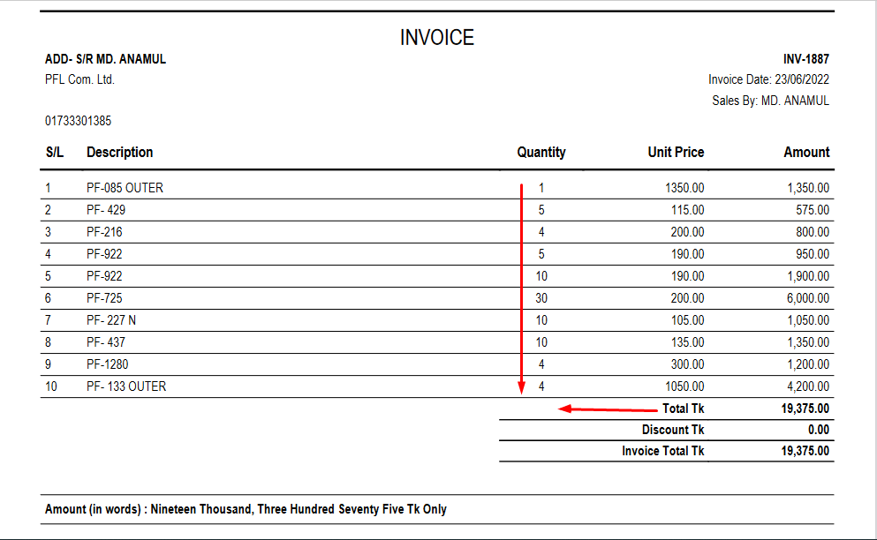
Example of Invoice Report

Slide 19
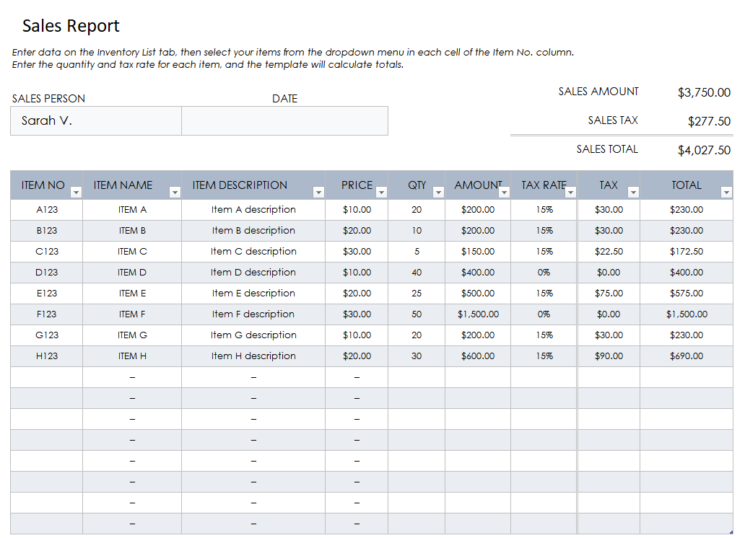
Sales Report Example

Slide 20
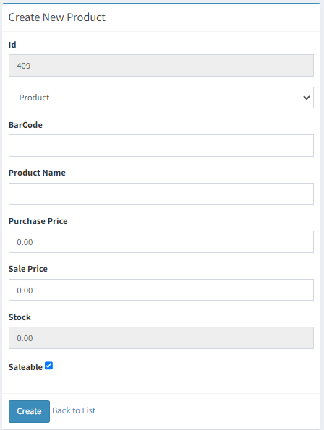
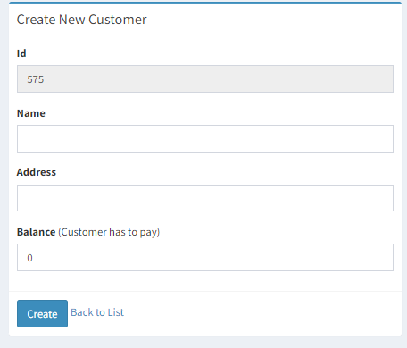
Form Sample

Slide 21
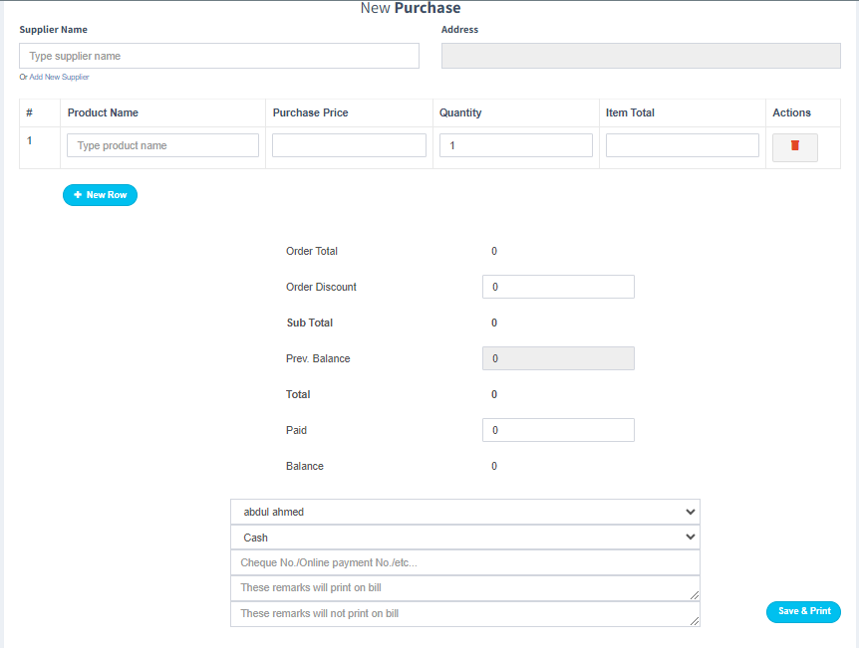
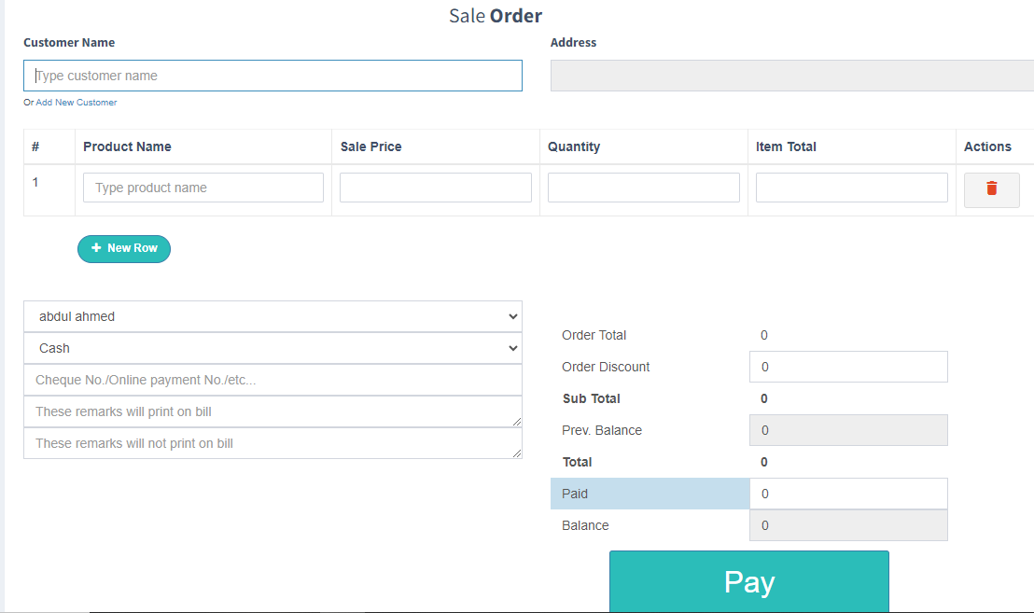
More Form Sample

Slide 22
Conclusion
Our store management software proposal offers a comprehensive solution for efficient inventory and sales management. With a well-defined Entity-Relationship Diagram (ERD) at its core, the software ensures seamless data organization and retrieval.
The ERD consists of interconnected tables such as "quantity," "role," "user," "customer," "sales_order," "stock," "brand," "category," "product," and "inventory_order." These tables facilitate various functionalities, including tracking product quantities, managing user roles, storing customer details, recording sales orders, monitoring stock levels, categorizing products, and managing inventory transactions.
In summary, our store management software proposal empowers businesses with efficient operations, optimized inventory control, and improved customer satisfaction. It is a valuable tool for businesses of all sizes, aiding in their growth and success.

Slide 23
Thank You

